Slide 1
Lariat Rental Fleet Profit Optimization Plan
By Jason Fong
8/2/2023

Slide 2
Objectives
Identify which vehicles identify the most profit on a day to day basis
Choose correct inputs for our revenue and cost models
Identify which input manipulation would increase revenue while reducing costs

Slide 3
Current Business Financials
Looking at our current revenue generated and costs incurred for the year 2018, Lariat Rental had made $7,284,336 in revenue and incurred $4,330,656 in costs. Hence, they had a profit of $2,953,680.
Using our model, we can see the effects of reducing our costs and increasing production in certain car models to increase profits.
There are a number of models in our fleet that produce little or even negative profits, and reducing costs in these models could prove profitable for Lariat.

Slide 4
Model Overview
For our model, we calculated the average profit per day for each car model and ranked it in descending order. We then split the models into three categories, those that generate more than $200/day, those between $100 and $200 a day, and those that generate less than $100 a day.
We allowed users to change revenue and costs for each category by a certain percentage. Depending on our user inputs, we can see the effect it has on our forecasted profit and compare it to our current profit(baseline).

Slide 5
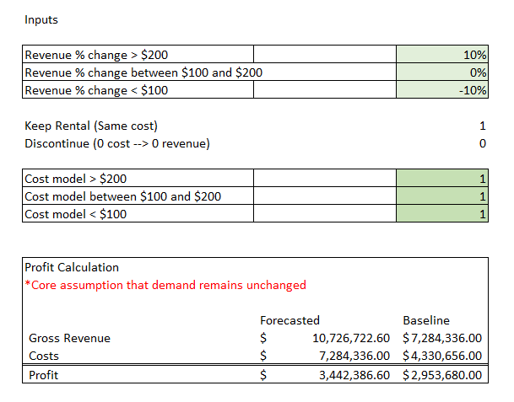
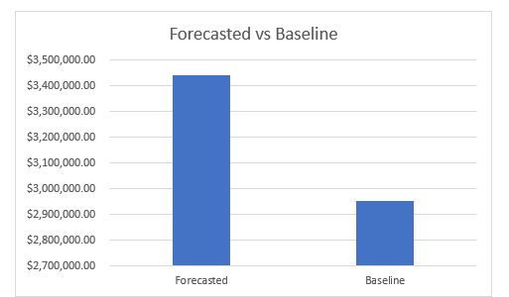
Model Overview (cont.)
Here is what our current input model looks like.

Slide 6
Revenue Maximation Strategy
Our model allows us to see what would happen if we had discontinued usage of vehicles that had a negative profit margin.
It goes without saying that we should discontinue those with a negative profit margin, and increase utilization of those that significant profit margins.
In our case, we would increase revenue% of vehicles that make over $200/day.

Slide 7
Revenue Maximation Strategy (cont.)
What we would recommend is that we should increase revenue production of those that generate over $200/day by 10 percent, decrease revenue production of those that make less than $100/day by 10%, and then discontinue those that have a negative profit margin. We this plan, we had profits of $3,442,386.60 compared to our baseline profit of $2,953,680.00.
Hence, we increase our profit by $488,706.60.

Slide 8
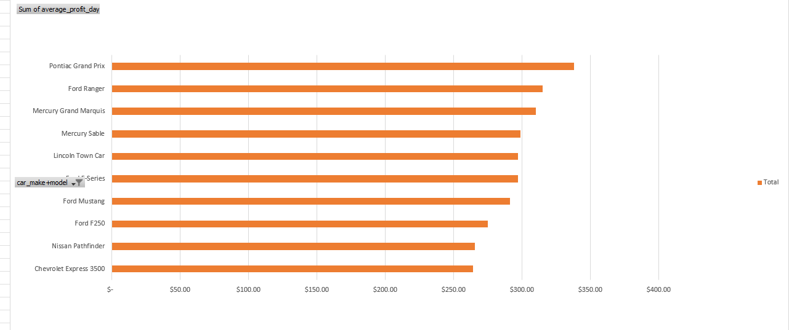
Revenue Maximation Strategy (cont.)

Slide 9
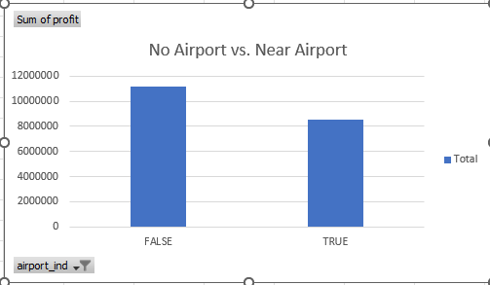
Consideration
Initially, we had plans of increased utilization of rental locations near airports. The logic behind it being that Lariat rental location near airports tend to have more customers due to the fact that people flying in from airports tend to need a car immediately after. However,

Slide 10
Conclusion
In conclusion, our strategy of increasing production of those than make over $200/day, decreasing production of those than make less than $100/day, and discontinuing those with a negative profit margin increased our net profit by approximately 17%.
Analysts and managers of Lariat Fleet can further optimize profit by adjusting inputs in our model, as our model allows users to immediately see differences in their new forecasted numbers and their baseline.

